Slide 1
Covid 19 Impact Analysis Using Python

Slide 2
Agenda
Introduction
Project idea
Data preparation
Analyzing the spread of covid 19
Conclusion

Slide 3
Introduction
the highly contagious nature of COVID-19 variants, the number of infected people outnumbered the number of doctors in hospitals, Waiting time for patients may lead to many problems in their medical cases.

Slide 4
Project Idea
The world was never prepared for the pandemic, therefore the initial wave of COVID-19 had an effect on the world . It caused an increase in cases, fatalities, unemployment, and poverty. You must examine the distribution of COVID-19 cases as well as all of the disease's effects on the world.

Slide 5
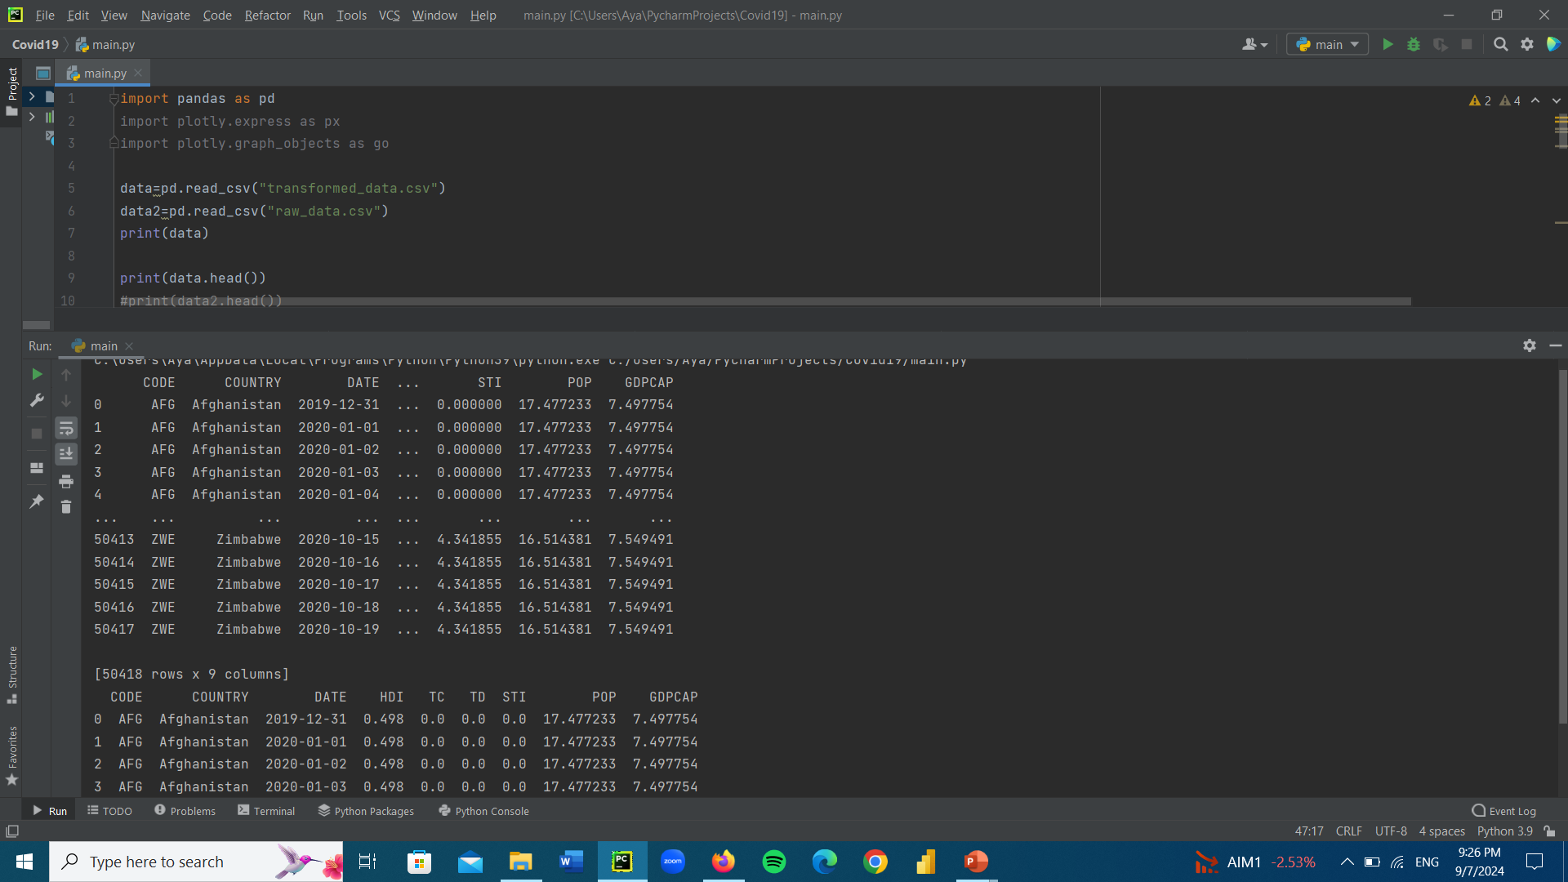
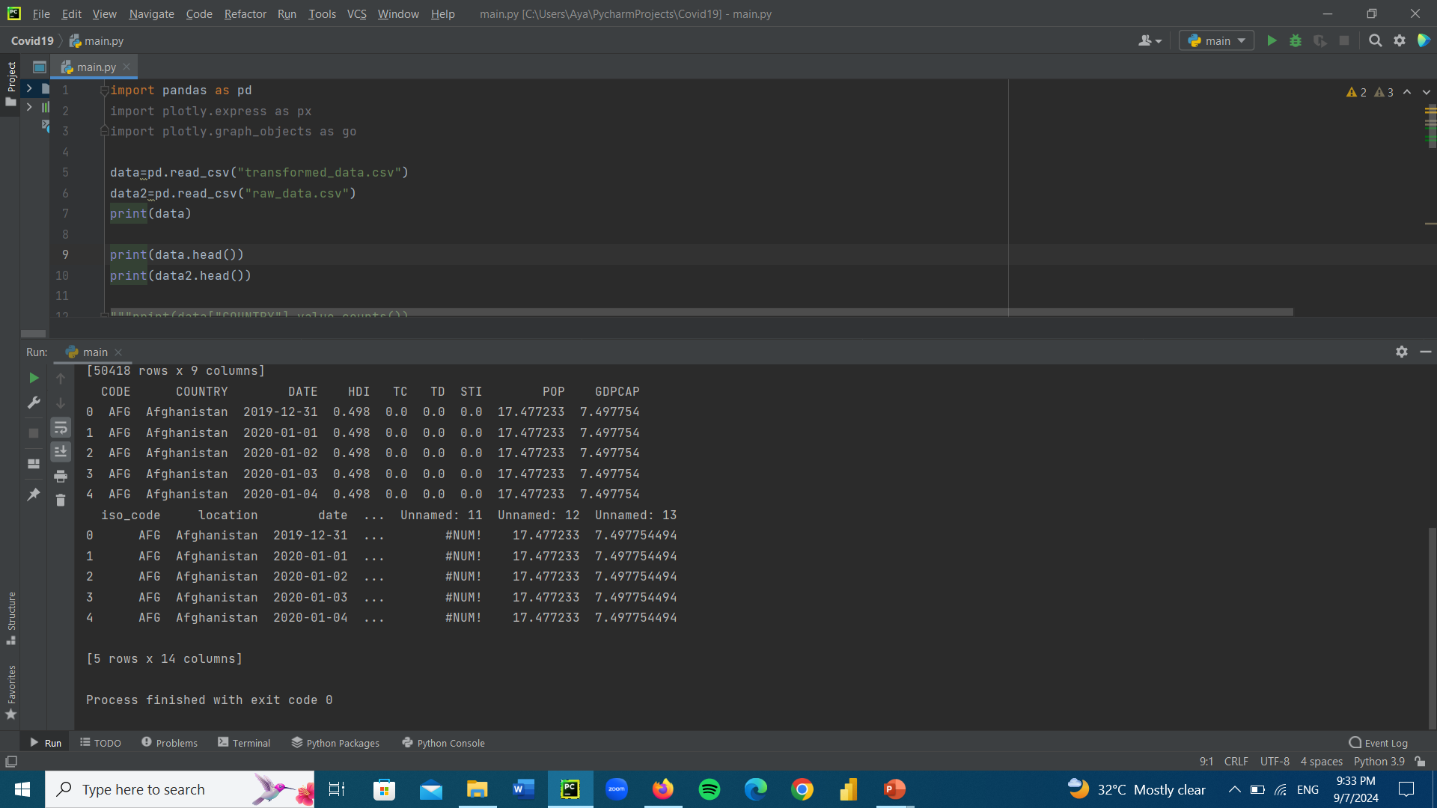
Data preparation
There are two files: one with raw data and the other with transformed data. However, as both datasets offer equally relevant information in separate columns, we must use them for this task. So let's examine each of the two datasets separately.

Slide 6
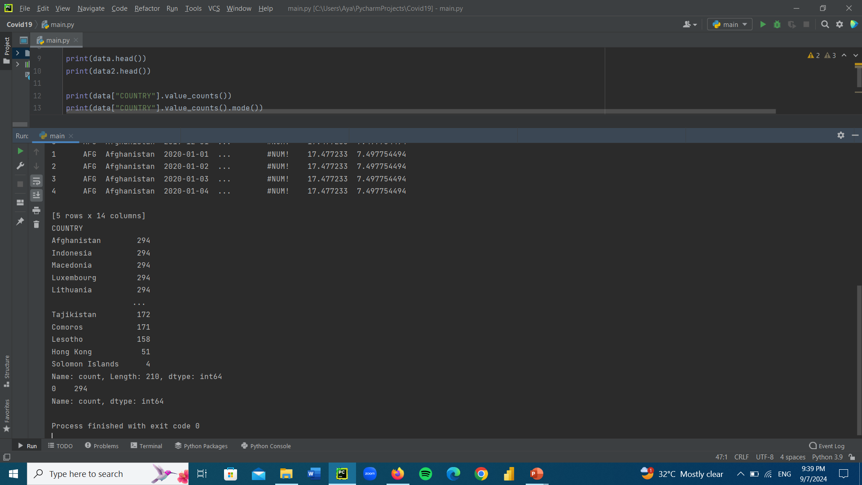
How many samples of each country are present in the dataset ?

Slide 7
So 294 is the mode value. We will need to use it for dividing the sum of all the samples related to the human development index.

Slide 8
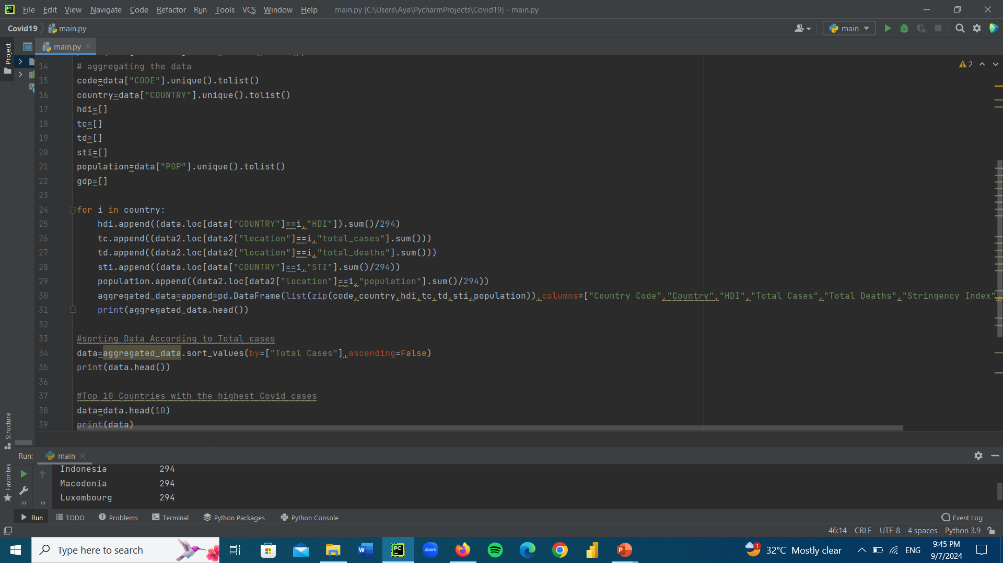
After generating initial conclusions on both datasets, I realized that we must merge them into a single new dataset.

Slide 9
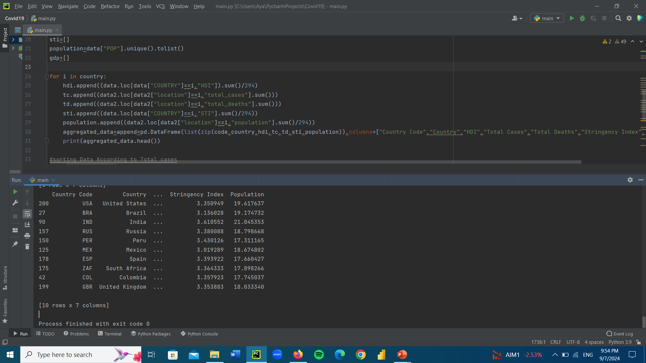
The top 10 countries with the highest number of covid-19 cases. It will be a perfect sample to study the economic impacts of covid-19.

Slide 10
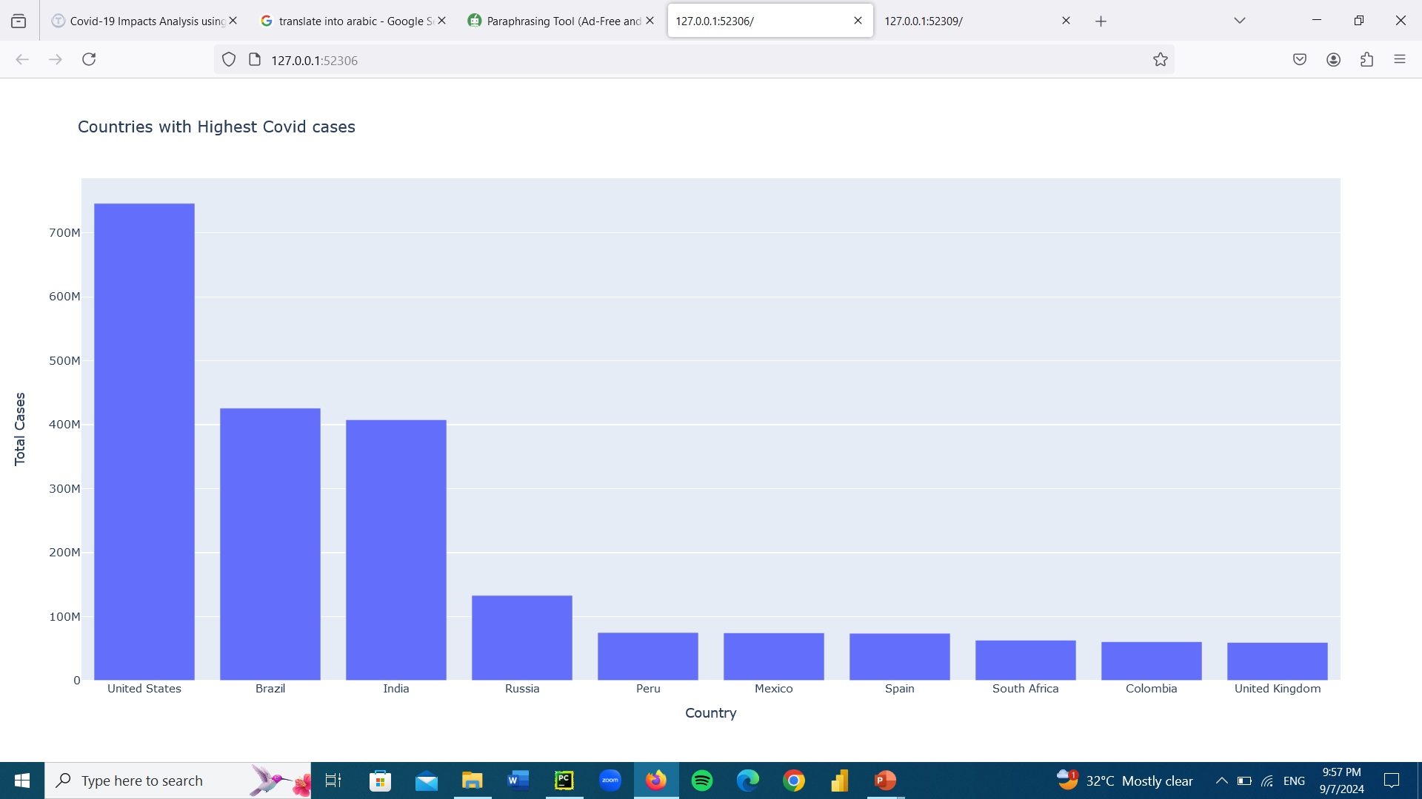
Analyzing the spread of Covid 19
All the countries with the highest number of covid-19 cases

Slide 11
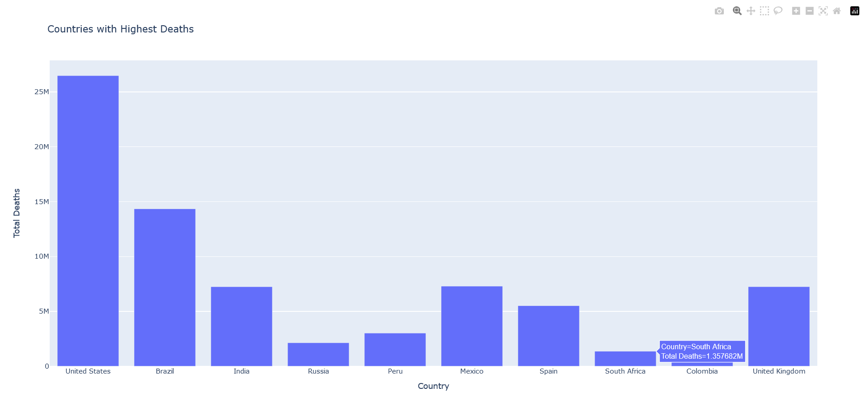
The total number of deaths among the countries with the highest number of covid-19 cases

Slide 12
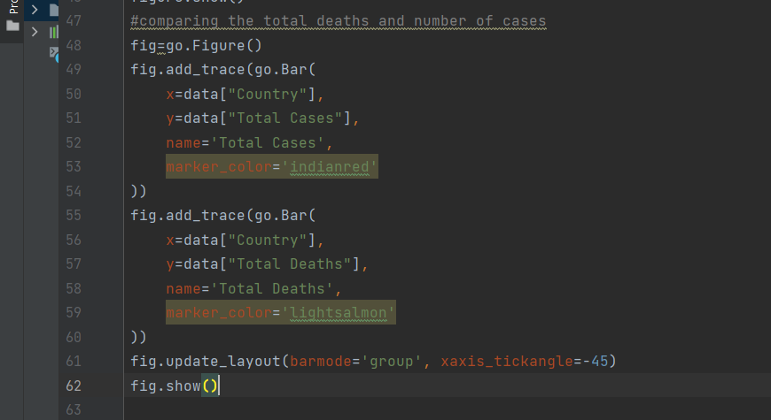
Comparing Between Number of cases & Total deaths in Each Country

Slide 13
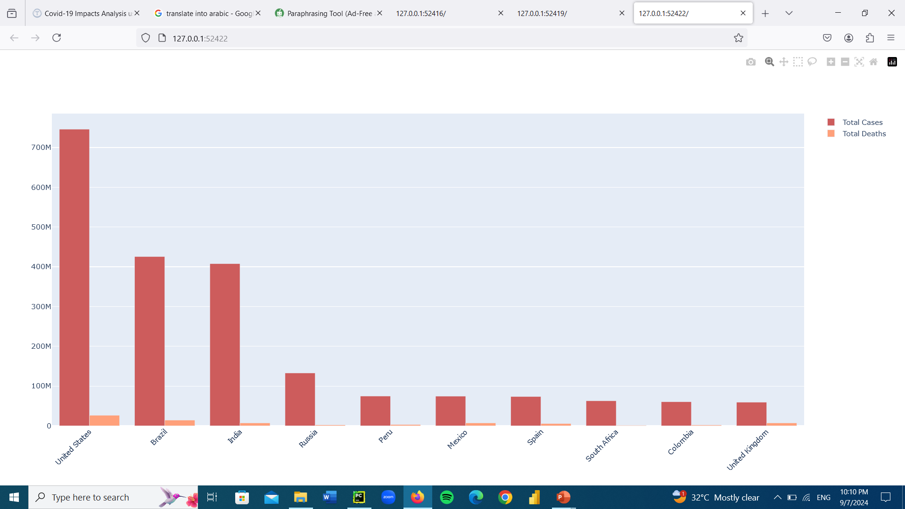

Slide 14
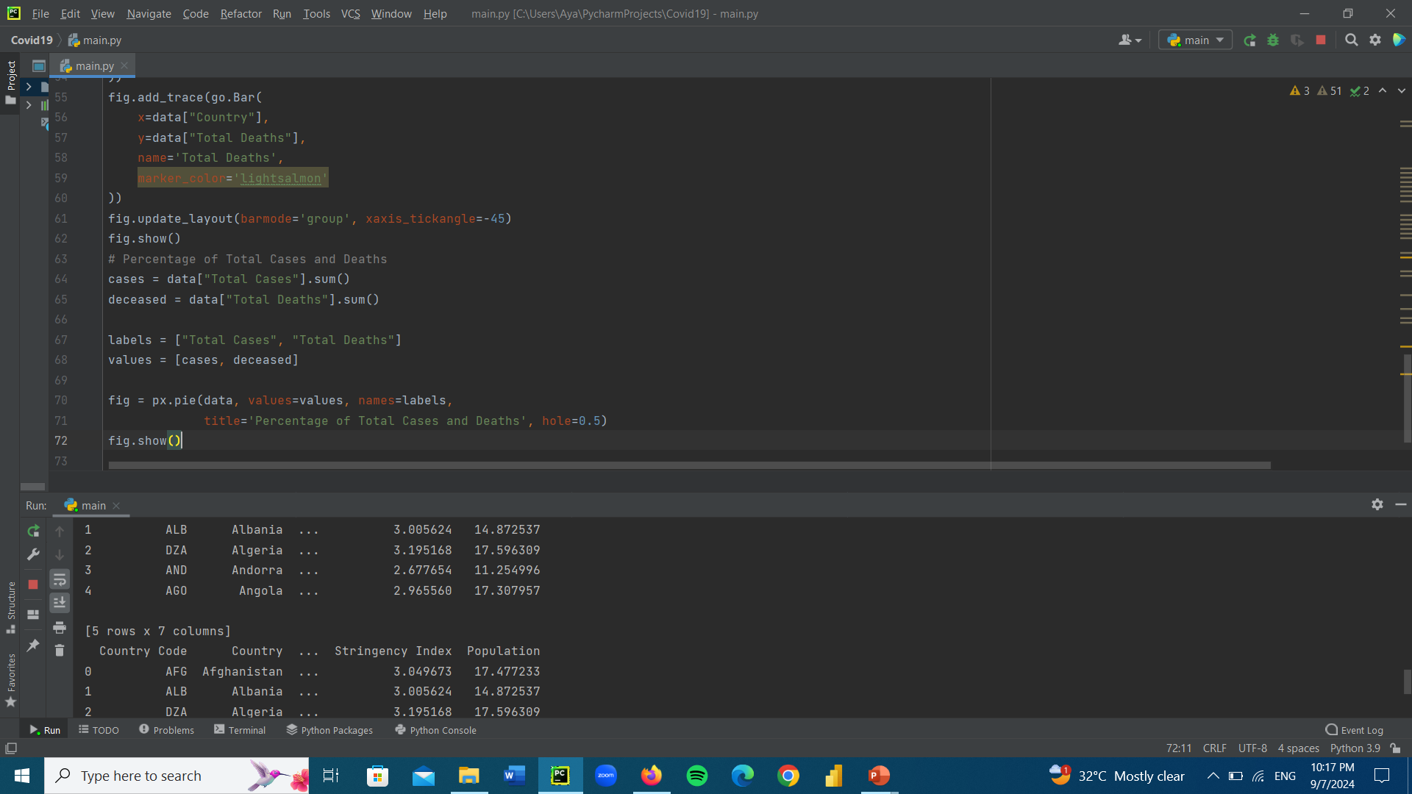
Calculating The percentage of Total Cases & Deaths

Slide 15
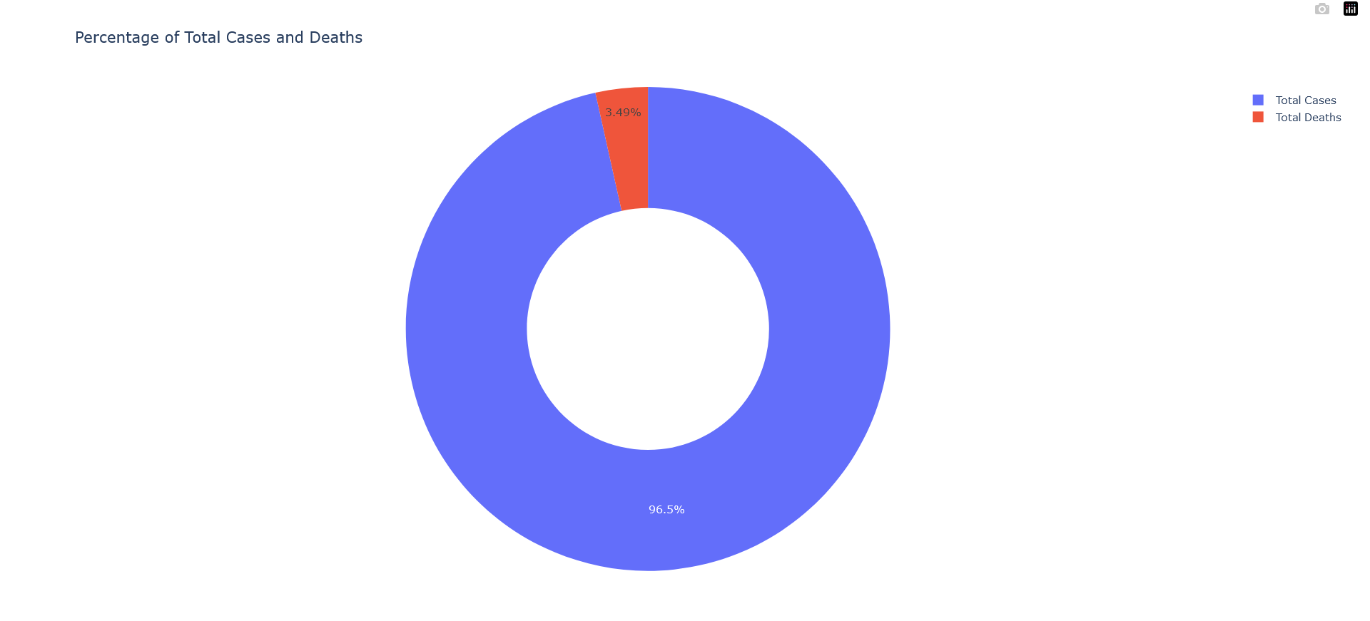

Slide 16

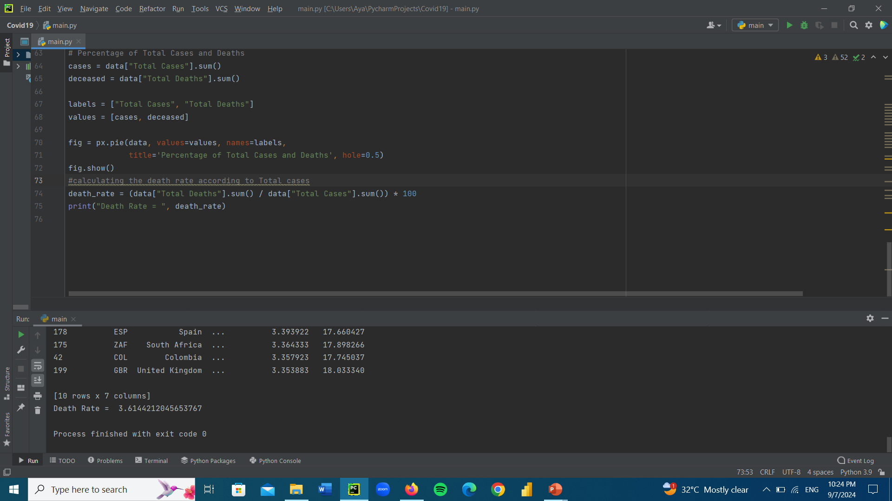
Calculating The death rate According to Total Cases

Slide 17
Conclusion
We analyzed the spread of COVID-19 across different countries in this project. As we've seen, the COVID-19 outbreak produced the greatest number of illnesses and fatalities in US history.

